Slide 1
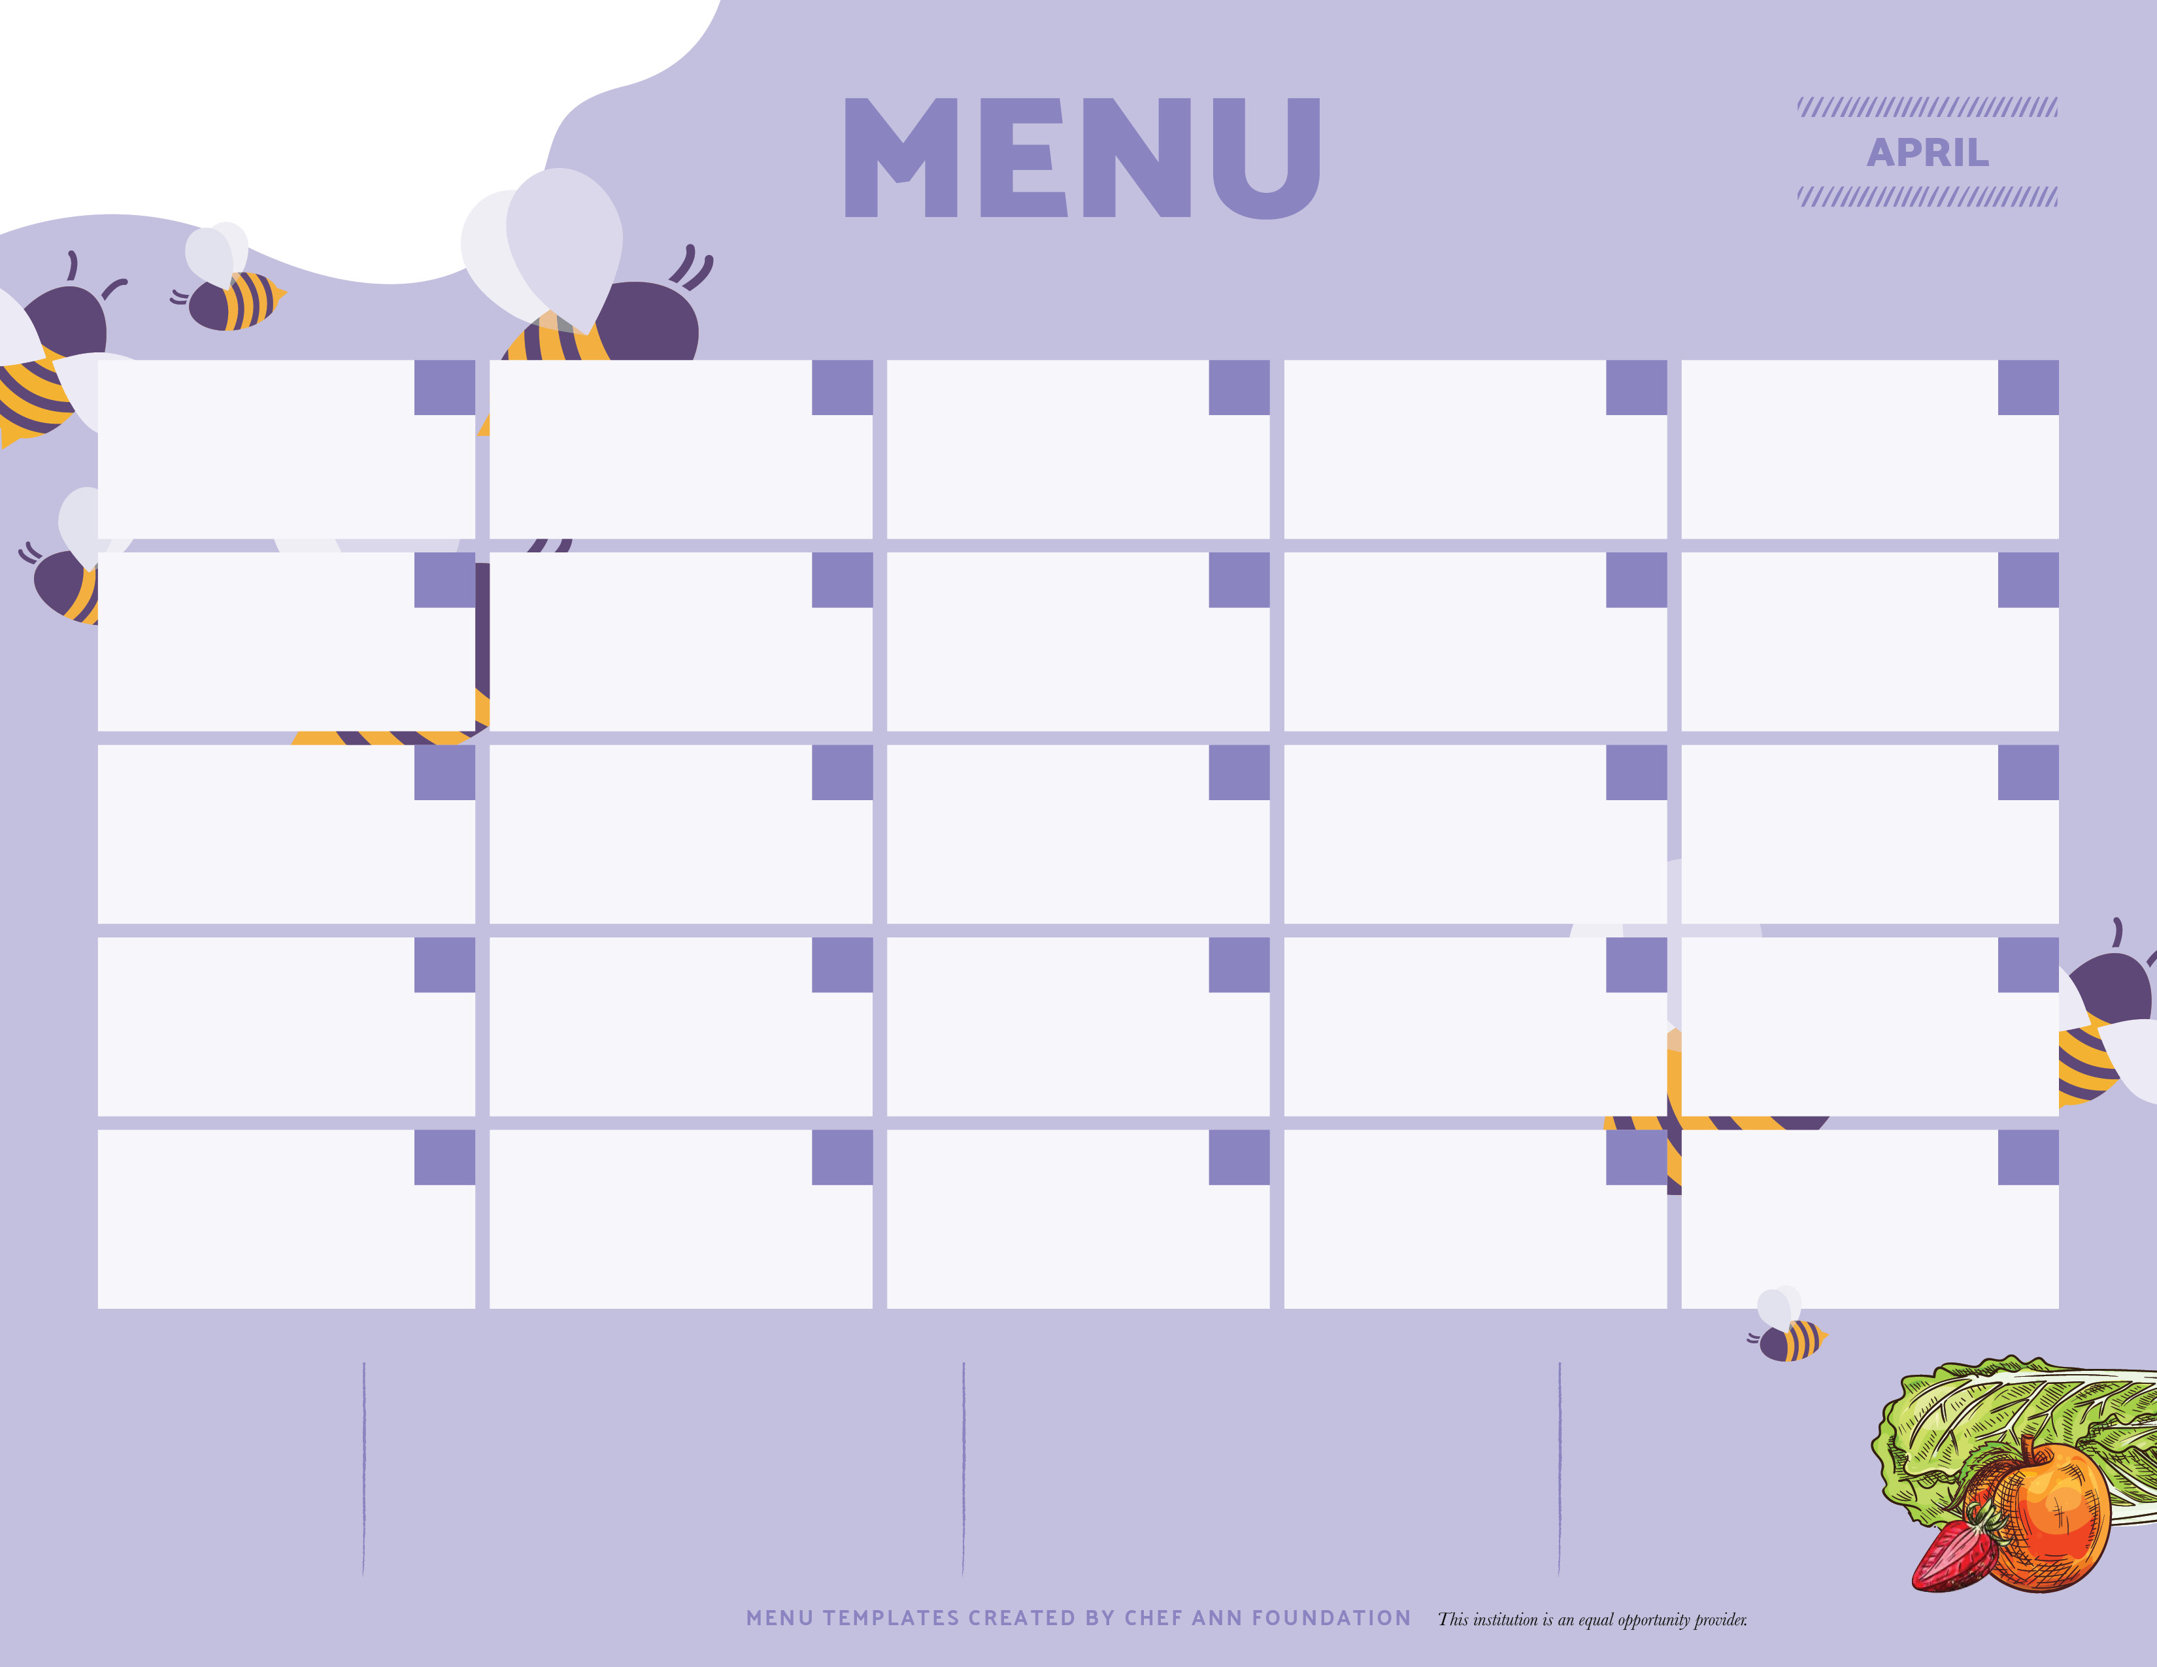


MASON ELEMENTARY SCHOOL BREAKFAST
00
01
02
03
04
CEREAL VARIETY
SMOOTHIE TUESDAY
100% JUICE
FRUIT & MILK
CEREAL VARIETY
BENEFIT BAR
100% JUICE
FRUIT & MILK
CEREAL VARIETY
BREAKFAST SANDWICH
100% JUICE
FRUIT & MILK
CEREAL VARIETY
YOGURT
100% JUICE
FRUIT & MILK
CEREAL VARIETY
ASSORTED MUFFINS
100% JUICE
FRUIT & MILK
07
CEREAL VARIETY
SMOOTHIE TUESDAY
100% JUICE
FRUIT & MILK
08
CEREAL VARIETY
BENEFIT BAR
100% JUICE
FRUIT & MILK
09
CEREAL VARIETY
BREAKFAST SANDWICH
100% JUICE
FRUIT & MILK
10
CEREAL VARIETY
YOGURT
100% JUICE
FRUIT & MILK
11
CEREAL VARIETY
ASSORTED MUFFINS
100% JUICE
FRUIT & MILK
14
CEREAL VARIETY
SMOOTHIE TUESDAY
100% JUICE
FRUIT & MILK
15
16
17
18
CEREAL VARIETY
BENEFIT BAR
100% JUICE
FRUIT & MILK
CEREAL VARIETY
BREAKFAST SANDWICH
100% JUICE
FRUIT & MILK
CEREAL VARIETY
YOGURT
100% JUICE
FRUIT & MILK
CEREAL VARIETY
ASSORTED MUFFINS
100% JUICE
FRUIT & MILK
21
CEREAL VARIETY
SMOOTHIE TUESDAY
100% JUICE
FRUIT & MILK
22
CEREAL VARIETY
100% JUICE
BENEFIT BAR
FRUIT & MILK
23
24
25
CEREAL VARIETY
BREAKFAST SANDWICH
100% JUICE
FRUIT & MILK
CEREAL VARIETY
100% JUICE
FRUIT & MILK
28
29
30
00
00
SPRING RECESS
BREAKFAST $2.00
MILK OR JUICE 50¢

